Slide 1
TWITTER SENTIMENT ANALYSIS
USING NATURAL LANGUAGE PROCESSING

Slide 2
PROJECT OVERVIEW
This project focuses on analyzing sentiment in Twitter data using Natural Language Processing (NLP) techniques. The main objectives include:
Preprocessing textual data to make it suitable for machine learning models.
Building and comparing different machine learning models, including traditional classifiers and autoencoders, to classify the sentiment of tweets as positive, negative, or neutral.
Evaluating the performance of these models using various metrics and drawing conclusions about their effectiveness.

Slide 3
DATASET DESCRIPTION
The dataset used in this project consists of Twitter data, specifically:
Training Dataset: twitter_training.csv containing tweets with corresponding sentiment labels.
Validation Dataset: twitter_validation.csv used to validate the model's performance.
Each tweet is labeled with one of three sentiment categories: positive, negative, or neutral.
The dataset includes text fields for the tweets, along with other metadata such as tweet IDs and timestamps.

Slide 4
PREPROCESSING STEPS
Text Cleaning:
Convert all text to lowercase to ensure uniformity.
Remove punctuation, stop words (like "the", "is", etc.), and numbers that do not contribute to the sentiment analysis.
Tokenization is performed using SpaCy’s en_core_web_lg model, which helps break down sentences into words and tokens.
Lemmatization:
Convert words to their base or root form (e.g., "running" to "run") to reduce vocabulary size and improve model accuracy.
Vectorization:
Text data is converted into numerical vectors using TF-IDF (Term Frequency-Inverse Document Frequency). This technique weighs the importance of words based on their frequency in a document relative to their frequency in the entire dataset.
Data Splitting:
The cleaned and vectorized data is split into training and validation sets to enable model training and performance evaluation.

Slide 5
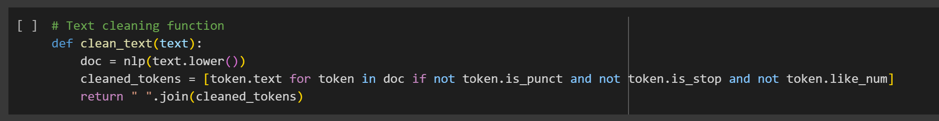
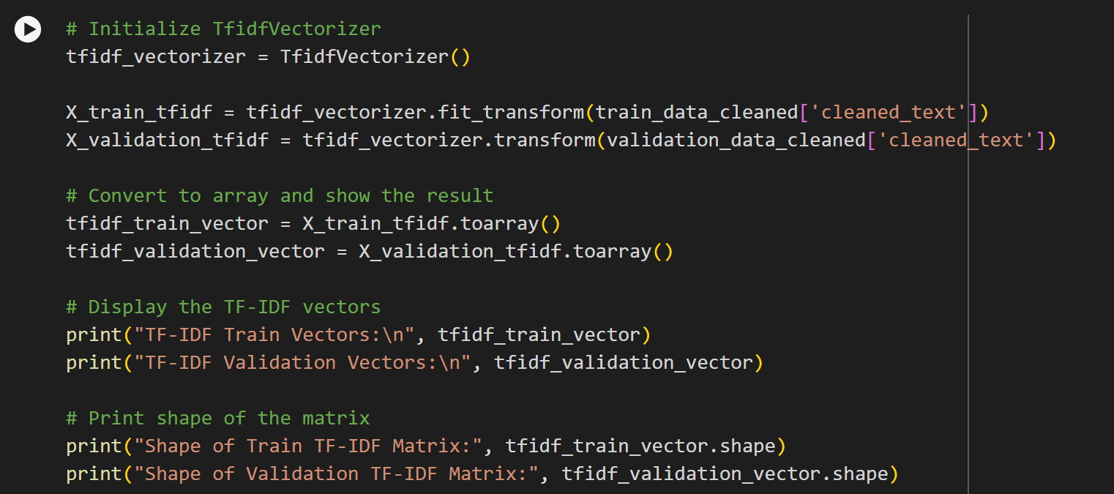
Text Cleaning
Vectorization

Slide 6
MODEL ARCHITECTURE
Random Forest Classifier:
An ensemble learning method that constructs multiple decision trees during training and outputs the mode of the classes (classification) or mean prediction (regression) of the individual trees.
This model is robust to overfitting and performs well on high-dimensional data like text.
Multinomial Naive Bayes:
A probabilistic learning method often used in text classification due to its simplicity and efficiency.
It assumes that the features (words) are conditionally independent given the class, which is rarely true in practice but still provides good results for text data.
Autoencoders:
Architecture: Autoencoders consist of an encoder and a decoder, where the encoder compresses the input into a lower-dimensional space (latent space), and the decoder reconstructs the input from this representation.
Purpose in this Project: Autoencoders were used to learn compressed representations of tweets, which could then be fed into traditional classifiers or analyzed for anomaly detection (e.g., detecting outlier sentiments).
Types Used: Simple feedforward autoencoders and potentially more complex architectures like convolutional autoencoders (if applicable).

Slide 7
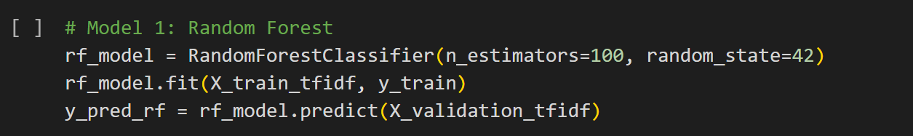
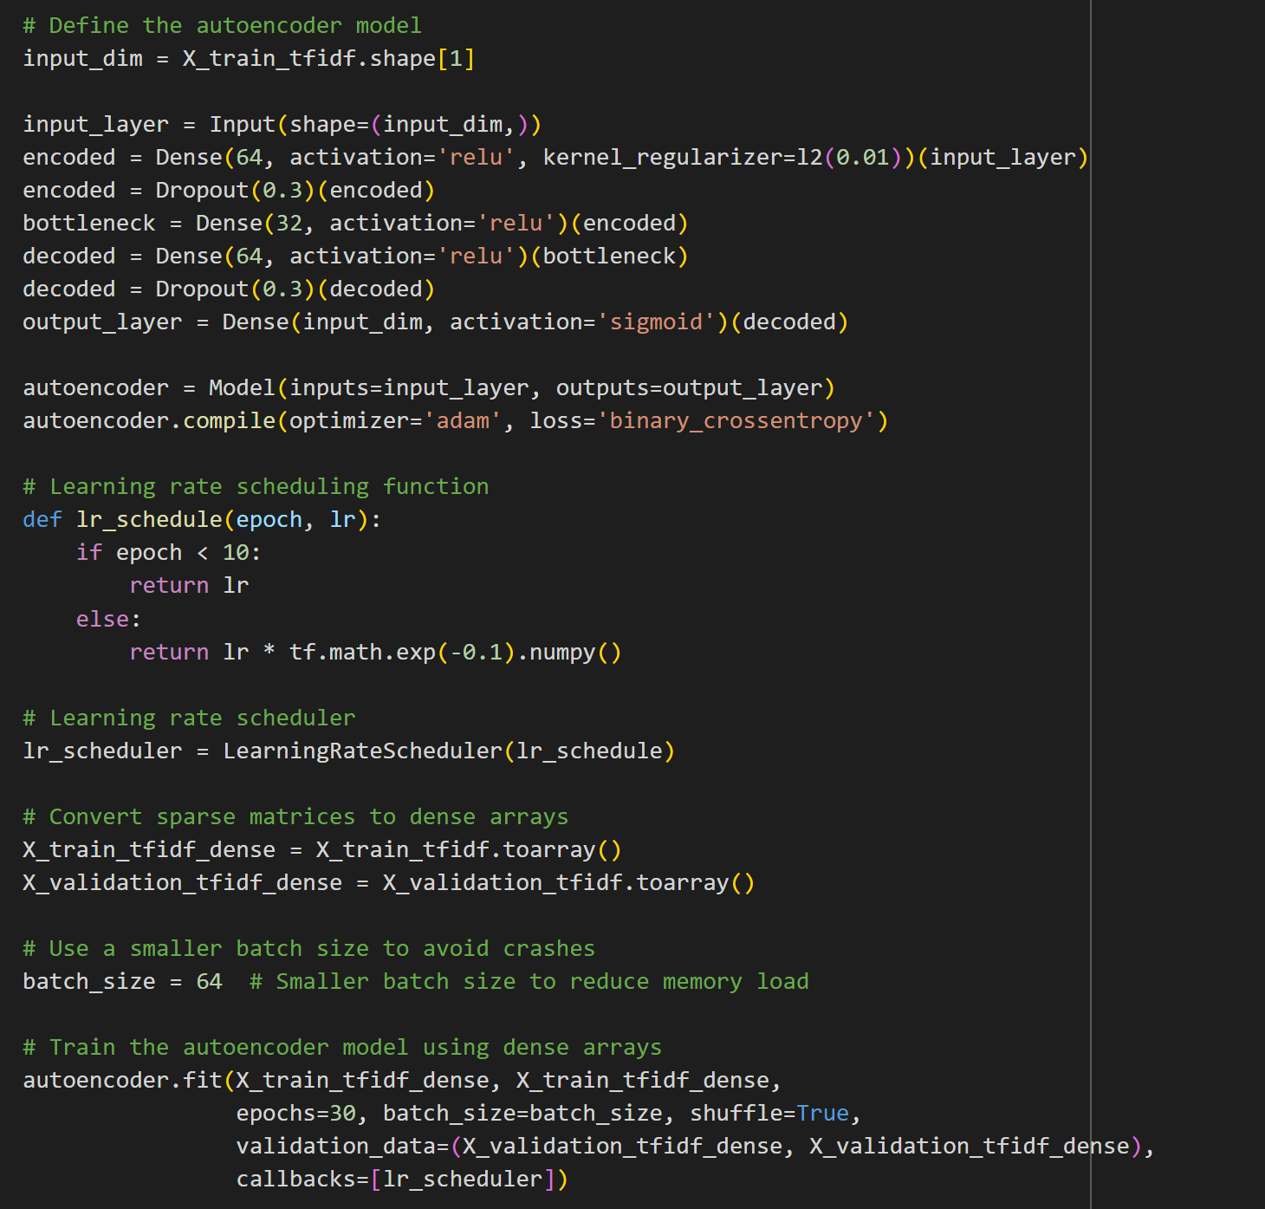
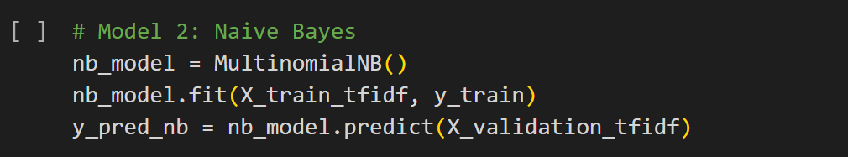

Slide 8
HYPERPARAMETER SETTINGS
Random Forest Classifier:
Number of Estimators: 100 (The number of trees in the forest)
Max Depth: None (Trees grow to full depth)
Min Samples Split: 2 (The minimum number of samples required to split an internal node)
Min Samples Leaf: 1 (The minimum number of samples required to be at a leaf node)
Multinomial Naive Bayes:
Alpha: 1.0 (Smoothing parameter, useful for dealing with zero probabilities)
Fit Prior: True (Learns class prior probabilities)
Autoencoders:
Encoder Layers: [128, 64, 32] (Example architecture: progressively reducing the dimensionality)
Decoder Layers: [32, 64, 128] (Mirroring the encoder to reconstruct the original input)
Activation Function: ReLU for hidden layers, Sigmoid for the output layer
Loss Function: Mean Squared Error (MSE) for reconstruction loss
Optimizer: Adam with a learning rate of 0.001

Slide 9
EVALUATION RESULTS
The models were evaluated using the following metrics:
Accuracy: The percentage of correct predictions among the total number of cases.
Precision: The ratio of correctly predicted positive observations to the total predicted positives.
Recall (Sensitivity): The ratio of correctly predicted positive observations to all observations in the actual class.
F1-Score: The weighted average of Precision and Recall, balancing the two metrics.
Random Forest Results:
Accuracy: 69.697%
Precision: 71.8%
Recall: 69.697 %
F1-Score: 68.9 %
Multinomial Naive Bayes Results:
Accuracy: 64.65%
Precision: 72.3%
Recall: 64.65%
F1-Score: 61.45%
Autoencoder:
Average Reconstruction Error (Validation): 0.0017588767
Reconstruction Error Threshold: 0.0028917385498061776
Number of Anomalies Detected: 3

Slide 10
MODEL COMPARISON
The Random Forest model generally outperformed the Naive Bayes model in terms of precision, recall, and F1-score.
The Autoencoder-based approach provided an interesting alternative, with the ability to reduce dimensionality and potentially improve classification performance, though it might require more computational resources.
Autoencoders could also be used for detecting anomalies in sentiment (e.g., identifying outlier sentiments that do not fit well within the usual patterns).

Slide 11
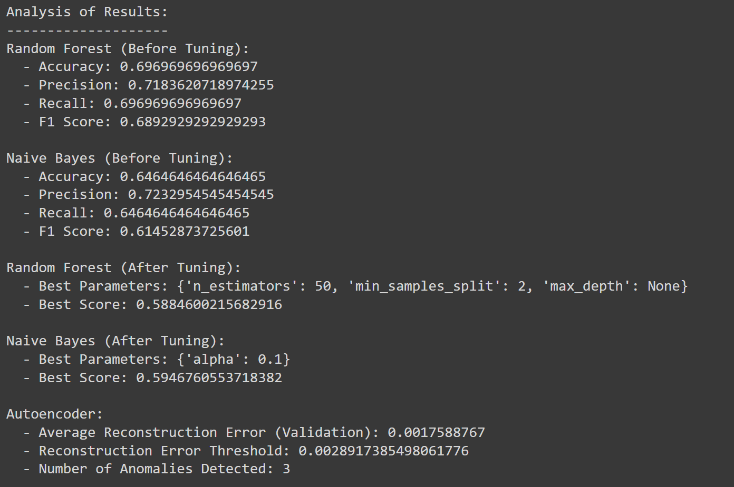

Slide 12
CONCLUSION & RECOMMENDATIONS
Conclusion:
The Random Forest classifier demonstrated superior performance on the sentiment classification task, making it the recommended model for similar text classification projects.
Autoencoders provided valuable insights by compressing the data into a lower-dimensional space, which can be useful for both classification and anomaly detection tasks.
Multinomial Naive Bayes is still a viable option for scenarios where computational efficiency is prioritized.
Recommendations:
Further Research: Consider experimenting with more advanced models like Transformers (BERT, RoBERTa) for potentially higher accuracy.
Dataset Augmentation: Increasing the size of the dataset or including more diverse tweets could improve model generalization.
Autoencoder Applications: Explore the use of autoencoders for more sophisticated anomaly detection or unsupervised sentiment analysis.
Feature Engineering: Investigating additional features such as tweet metadata (e.g., hashtags, mentions) could enhance model performance.

Slide 14

LINK

Slide 15
THANK YOU!
Karan Panchal
karan2261panchal@gmail.com
GitHub

